Slide 1
Robust & correct programming
Dr. Jeff Hill

Slide 2
Common error sources
Here are some common sources of programmatic errors:
Weak data typing and variable declarations
Array indexes (buffer overflows in unchecked languages)
Pointers
Memory leaks
Which ones does Java inherently protect us against?
Java is a strongly typed language, array index are checked for validity, pointers are not directly manipulable, Java has garbage collection
Does this mean Java programs are inherently robust and never fail?

Slide 3
Common correctness problems
Note: these are not Java problems
These occur with all languages!
Numeric computations:
Integer overflow
Use BigInteger to fix
Float rounding error
Use double to fix
Double imprecision
Use BigDecimal to fix
int a = 2000000000;
int b = 2000000000;
System.out.println("a + b = " + (a+b));
float a1 = 1234567.12f;
float b1 = 7654321.65f;
System.out.println("a1 + b1 = " + (a1+b1));
double a2 = 1.0;
double b2 = 1.1;
System.out.println("a2 - b2 = " + (a2-b2));
Are these exceptions?

Slide 4
Simple correctness fixes
Use proper data types
float and double have subtle differences
Use each appropriately
BigInteger & BigDecimal allow for much larger values to be stored
BigDecimal also fixes imprecision problem
Very frequently used for currency data!
BigInteger a3 = new BigInteger("2000000000");
BigInteger b3 = new BigInteger("2000000000");
System.out.println("a3 + b3 = " + a3.add(b3));
double a4 = 1234567.12;
double b4 = 7654321.65;
System.out.println("a4 + b4 = " + (a4+b4));
BigDecimal a5 = new BigDecimal("1.0");
BigDecimal b5 = new BigDecimal("1.1");
System.out.println("a5 - b5 = " + a5.subtract(b5));

Slide 5
Exception handling
What is exception handling?
Why is it useful?
Is it required?
Do exceptions always represent a problem?
What is the difference between the words robustness and correctness?
Which does exception handling help us provide?

Slide 6
Exceptions
Some problems aren’t fixable by using different data types
Why are these problematic?
How do we fix them?
System.out.println("5 / 0 = " + 5/0);

Slide 7
Try/Catch blocks
Java throws an exception
An exception is an object
That exception is caught into a variable named ‘e’ by convention (‘ex’ is frequently used as well)
Create 2 code blocks
One for try this
One for shoot, that didn’t work
try {
System.out.println("5 / 0 = " + 5/0);
} catch (Exception e) {
System.out.println("oops... this happened: " + e.getMessage());
e.printStackTrace();
} // end catch
So what? What is so great about exception handling?

Slide 8
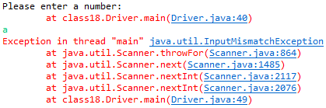

More about exceptions
System.out.println("Please enter a number: ");
Scanner input = new Scanner(System.in);
int grade = input.nextInt();
System.out.println("You entered the number: " + grade);
Are exceptions always code or logic problems?
Then what are they?
They are exceptional cases, not what was expected or something out of the norm
We can use this to protect against user errors
What happens if we type in a letter instead?

Slide 9

The simplistic fix
try {
System.out.println("Please enter a number: ");
Scanner input2 = new Scanner(System.in);
int grade2 = input2.nextInt();
System.out.println("You entered the number: " + grade2);
} catch (Exception e) {
System.out.println("I said enter a number!");
} // end catch
This kept the program from crashing, but what is the problem?
Do we have a way to make a section of code execute again and again and again until we tell it to stop?

Slide 10
The proper fix
Note: the loop must be around the exception handling, otherwise an exception will exit the loop!
boolean keepGoing = true;
// define input3 and grade3 here due to scope!
Scanner input3 = new Scanner(System.in);
int grade3 = 0;
while (keepGoing) {
try {
System.out.println("Please enter a number: ");
grade3 = input3.nextInt(); // if the entry isn't valid, an exception is generated
// if we make it to this line of code, we know an integer was entered!
// set the sentinel to let us out of the loop
keepGoing = false;
} catch (Exception e) {
System.out.println("I said enter a number!");
input3.nextLine(); // clears the bad entry from the Scanner's buffer
} // end catch
} // end while
System.out.println("You entered the number: " + grade3);
Don’t forget about scope as we’re creating many different code blocks!
Forgetting this line will create an infinite loop of exceptions!

Slide 11
Finally
Are try and catch the only code blocks associated with exception handling?
Often used to “clean up”
Close connections to databases, files, network resources, etc.
Are finally blocks required?
When are they executed?
Will the finally block always execute?
Even if an exception occurred?

Slide 12
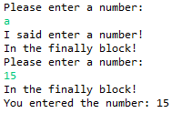
Finally
boolean keepGoing2 = true;
// define input4 and grade4 here due to scope!
Scanner input4 = new Scanner(System.in);
int grade4 = 0;
while (keepGoing2) {
try {
System.out.println("Please enter a number: ");
grade4 = input4.nextInt(); // if the entry isn't valid, an exception is generated
// if we make it to this line of code, we know an integer was entered!
// set the sentinel to let us out of the loop
keepGoing2 = false;
} catch (Exception e) {
System.out.println("I said enter a number!");
input4.nextLine(); // clears the bad entry from the Scanner's buffer
} finally {
System.out.println("In the finally block!");
} // end finally
} // end while
System.out.println("You entered the number: " + grade4);
Note: the finally block executed twice!

Slide 13

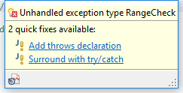
Mandatory Exception Handling
What is the other name this is known as?
What are checked exceptions used for?
Why would a programmer use checked exceptions?
This is the error you receive if you attempt to invoke a method that requires checked exceptions without exception handling

Slide 14
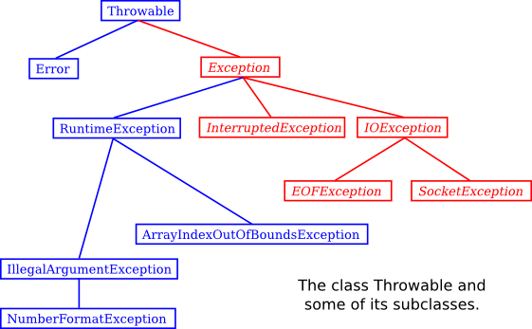
Custom Exception Types
Exceptions are objects
All objects have what?
We can create our own exception types
Exceptions inherit from the class Exception
Eck, D. (2015) Section 8.3.1
Text shows similar chart on p.549
Notes:
Data (or object) type

Slide 15
Putting It Together
package class18;
public class RangeCheck extends Exception {
public RangeCheck(String inc) {
super(inc);
} // end ctor
} // end RangeCheck
public static int doCalculation(int a, int b) throws RangeCheck {
if (a < 0 || b < 0) {
throw new RangeCheck("Arguments must be greater than zero!");
} // end if
return a/b;
} // end doCalculation
public static void main(String[] args) {
try {
System.out.println(doCalculation(15, 5));
} catch (RangeCheck e) {
System.out.println(e.getMessage());
} // end catch
System.out.println("All is operating normally.");
} // end main
This is how we define our own exception type and declare that users of our method MUST check for our custom exception type
Does this fix all possible problems? What happens if we change “5” to “0”?

Slide 16
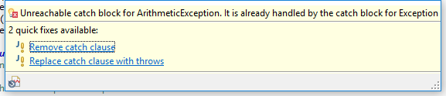
Multiple catch blocks
try {
System.out.println(doCalculation(15, -5));
} catch (RangeCheck e) {
System.out.println("Oops." + e.getMessage());
} catch (ArithmeticException e) {
System.out.println("Oops." + e.getMessage());
} catch (Exception e) {
System.out.println("Oops." + e.getMessage());
} // end catch
System.out.println("All is operating normally.");
What would happen if we moved Exception to be first in the list?
The order you specify the “catch” blocks is the order Java will follow, first match wins

Slide 17
Questions?

